Slide 1
Introduction to OOP in Python
Object-Oriented Programming (OOP) is a programming paradigm based on the concept of objects, which can contain data and code.

Slide 2
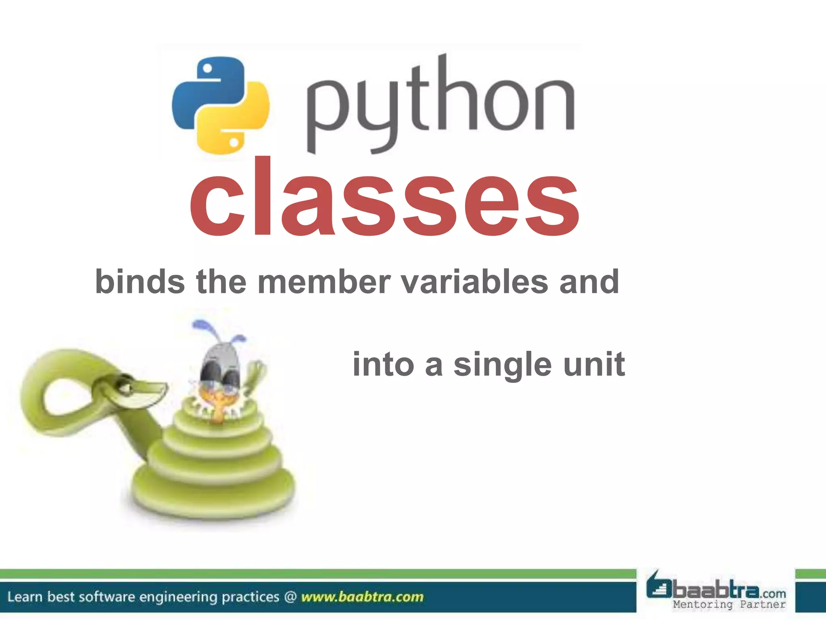

Slide 3
Classes and Objects
A class is a blueprint for creating objects. An object is an instance of a class.
class Dog:
def __init__(self, name, age):
self.name = name
self.age = age
my_dog = Dog("Buddy", 3)

Slide 4
Attributes
Attributes are variables that belong to an object or class. They define the properties of the object.
Attributes that are specific to each instance of a class. They are defined within methods, typically within the ‘_init_’ method, and are prefixed with ‘self’ to indicate that they belong to the instance.
class Dog:
def __init__(self, name, age):
self.name = name
self.age = age
my_dog = Dog("Buddy", 5)
print(my_dog.name) # Output: Buddy
print(my_dog.age) # Output: 5

Slide 5
Methods
Methods are functions that belong to an object or class. They define the behaviors of the object.

Slide 6
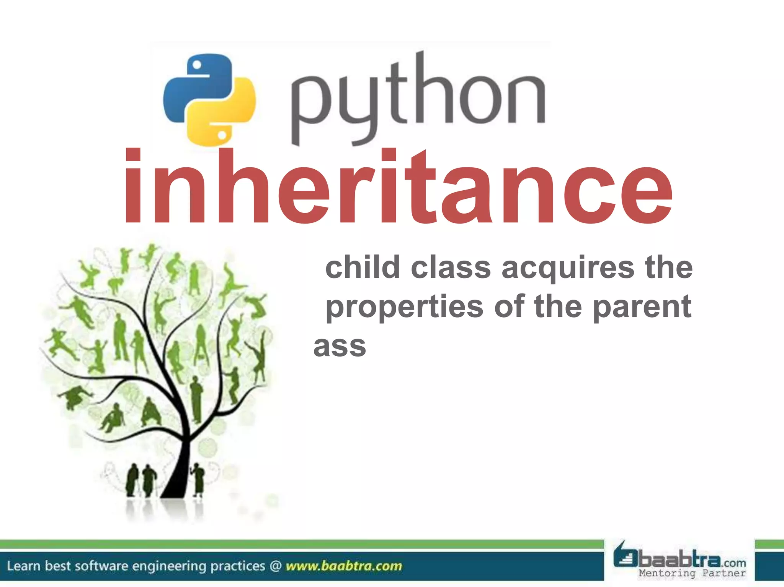

Slide 7
Inheritance
Inheritance allows a class to inherit attributes and methods from another class.
Code Example:
class Animal:
def __init__(self, name):
self.name = name
class Dog(Animal):
def __init__(self, name, breed):
super().__init__(name)
self.breed = breed

Slide 8
Polymorphism
Polymorphism allows objects of different classes to be treated as objects of a common superclass.
Code Example:
class Bird:
def sound(self):
print("Chirp")
class Dog:
def sound(self):
print("Bark")
for animal in (Bird(), Dog()):
animal.sound()

Slide 9
Encapsulation
Encapsulation restricts access to certain components of an object, protecting the object's integrity.
Code Example:
class Car:
def __init__(self, model, year):
self.__model = model
self.__year = year
def get_model(self):
return self.__model

Slide 10
Abstraction
Abstraction hides the complex implementation details of an object and exposes only the necessary parts.
Code Example:
from abc import ABC, abstractmethod
class Animal(ABC):
@abstractmethod
def sound(self):
pass

Slide 11
Example: Creating a Class
Example: Creating a simple class in Python to represent a Car object.

Slide 12
Conclusion
OOP in Python allows for more organized and reusable code. It is a powerful tool for modern programming.

